Slide 1
CS623 : Data Structures & Algorithm Analysis
Chapter 3: Tree

Slide 2
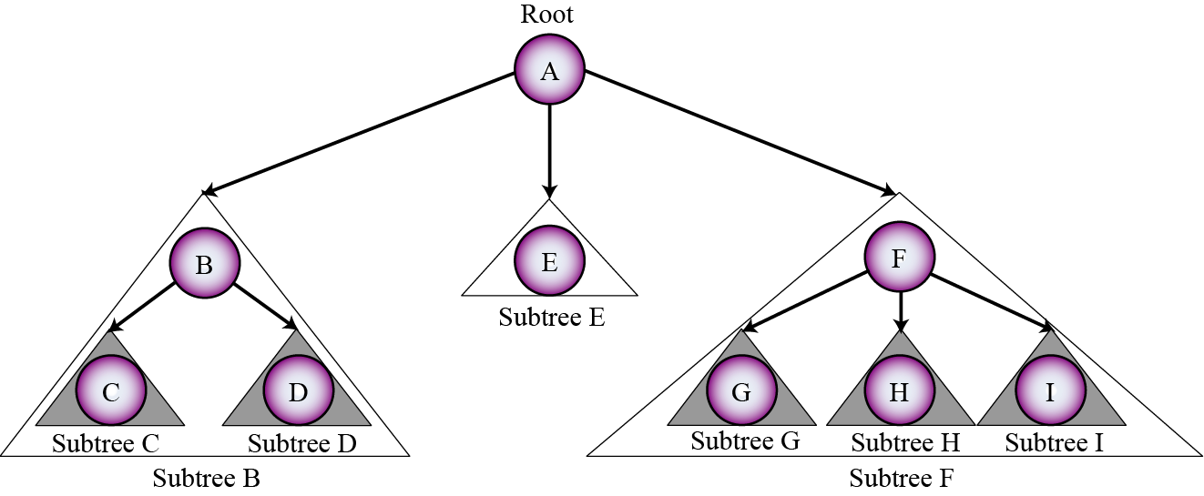
Tree: Recursive Definition
A general tree is a finite set of nodes, i.e. either empty or not, which has a designated node called the root node from which (hierarchically) descend zero or more sub-trees. A number of sub-trees may be constituted from the same tree by rooting at each of the nodes in a recursive manner.

Slide 3
Tree: Non recursive Definition
A tree is an abstract data structure consists of a finite set of elements, called nodes (or vertices) and a finite set of directed lines, called arcs (edges), that connect pairs of the nodes.
Nodes
A
Edges
B
E
F
C
D
G
H
I

Slide 4
Tree: a Rooted Tree
A rooted tree is a tree with the following properties.
One node is distinguished as the root.
Every node c, except the root, is connected by an edge from exactly one other node p. Node p is c's parent, and c is one of p's children.
A unique path traverses from the root to each node. The number of edges that must be followed is the path length.
Root node
A
B
E
F
C
D
G
H
I
J
K
L
M
N

Slide 5
Terminologies
A node that has a sub-tree is the parent of that sub-tree (e.g. node A has three sub-trees and is the parent of nodes B, C and D).
A node which is not a parent is called a leaf (C, D, E, G, H, I)
An internal node is any node that has at least one non-empty child.
Every node in a tree is the root of some sub-tree (even if an empty one).
The number of sub-trees rooted at a node is called the degree of that node. (E.g. node F is of degree 3)
The degree of the tree is the degree of the node that has the maximum degree.

Slide 6
Terminologies
Children of same parent are called siblings.
The ancestors of a node are all the nodes along the path from the node to the root.
The descendents of a node are all the nodes that are in its children sub-trees.
The root node is said to be at level 0, its children at level 1; their children at level 2 and so on.
The depth of a node is the number of levels or edges traversed from the root to the node.
The height of a node is the number of levels or edges traversed from the node to its furthest leaf.
The height of a tree is the height of the root node.
In a tree, there is only one unique path from the root to a node.

Slide 7
Binary Tree
A binary tree is a tree in which each node has at most two children. Each node in the BT has 0,1, 0r 2 children. The node to the left of a node, if it exists, is called its left child. The node to the right of a node, if it exists, is the right child.
A
B
C
D
E
F
F
G
H
I

Slide 8
Something to Ponder
What is the maximum number of node at any level n of a binary tree?
What is the maximum number of node in a binary tree of depth d?
What is the maximum possible height(or depth) of a binary tree with n number of nodes?
What is the minimum number of levels that a binary tree with n nodes can have

Slide 9
Array Implementation of BT
Implementing binary Tree using an array: no need for explicit parent or child pointers.
Convert the tree into a full binary tree by adding dummy nodes containing dummy values
Number the nodes (including the dummy node) across the level from left to right starting from the root at level 0 and moving down the levels.
Size of array = 2^{d+1}-1, where d is the depth of the tree (root is at level 0)
Put the value of the nodes in the corresponding position on the array
The nodes are inserted in the tree as follows:
Store the root at first location (index 0)
If a node is at location i, store its left child at location 2i+1 and its right child at 2i+2.

Slide 10
Example: Array Implementation
99
91
83
77
64
63
14
48
55
7

Slide 11
Example: Array Implementation
99
0
91
83
1
2
77
64
D
63
3
4
5
6
14
48
D
55
D
D
7
D
7
8
9
10
11
12
13
14
Where nodes represented by D are dummy nodes

Slide 12
Example: Array Implementation
0 | 99
1 | 91
2 | 83
3 | 77
4 | 64
5 | Dummy
6 | 63
7 | 14
8 | 48
9 | Dummy
10 | 55
11 | Dummy
12 | Dummy
13 | 7
14 | Dummy
Depth = 3
Array Size = 2³⁺¹- 1= 15
99
0
91
83
1
2
77
64
D
63
3
4
5
6
14
48
D
55
D
D
7
D
7
8
9
10
11
12
13
14

Slide 13
Array Implementation...
Given a child, its parent node can be identified (easily) and vice versa
Parent(i) = ⎣(i-1)/2⎦
Left(i) = 2i + 1
Right(i) = 2i + 2

Slide 14
Exercise: Array Implementation of BT
See how the following operations can be served:
Create()
isEmpty()
Traverse()
Find( item, location)

Slide 15
Array Implementation of BT Efficiency Consideration
Adv:
- Simplicity
- Given a child, its parent node can be identified (easily) and vice versa
Disadv:
- Wastage of space (esp. if the tree is not balanced)
- Reordering the elements due to shifting in case of deletion.

Slide 16
Pointer Implementation of BT
Node Construction/Declaration:
template <class T>
struct nodeTree {
T data;
nodeTree <T> * left;
nodeTree <T> * right;
};
BT Construction:
nodeTree <int> * root; // contains the address of the root node

Slide 17
BT Operations
See how the following operations can be served:
Create(root)
isEmpty(root)
Traverse(root)
Find(root, item, location)
Add(root, node)
Remove(root, node)

Slide 18
Create()
template <class T>
void create(nodeTree<T> * & root) {
root = NULL;
}

Slide 19
isEmpty()
template <class T>
int isEmpty(nodeTree<T> * root){
return (root == NULL);
}

Slide 20
Tree Traversal
Any process that requires each node of the tree be processed once and only once in a predetermined sequence is called a traversal.
There are two class of traversal that need special attention: Breadth First Traversal and Depth First Traversal

Slide 21
Breadth First Traversal
This traversal visits each node starting from the lowest(or highest) level and moving down(or up) level by level visiting nodes on each level from left to right (or from right to left).
Visit the sibling before the children(or parent).
There are four possibilities:
Top-down, left to right
Top-down, right to left
Bottom-up, left to right
Bottom-up, right to left
Implementation of this kind of traversal is straightforward if we use a queue.

Slide 22
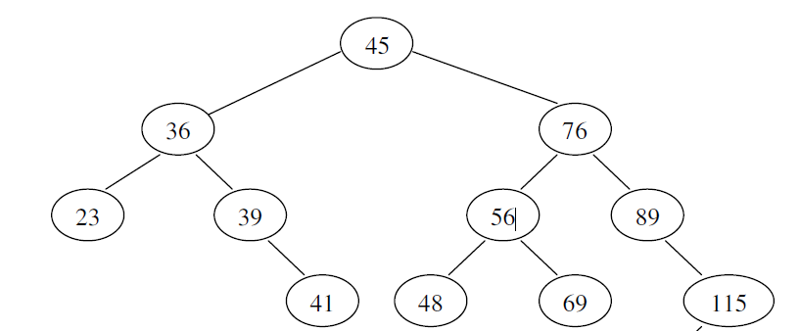
Breadth First: Top-down, left to right
45, 36, 76 , 23, 39, 56, 89, 29, 41, 48, 69, 115, 26, 31
29
26
31

Slide 23
Breadth First: Top-down, left to right
template <class T>
void bredthFirst(nodeTree <T> * root) {
Queue<nodeTree <T> *> q;
nodeTre<T> * p=root;
if (p !=NULL) {
q.enQueue(p);
while(!q.isEmpty()){
p=q.deQueue();
“visit” p->data;
if(p->left != NULL)
q.enQueue(p->left);
if(p->right != NULL)
q.enQueue (p->right);
}
}
}

Slide 24
Breadth First Bottom-up, left to right: Exercise
The implementation of bottom-up left to right traversal can be obtained easily if we observe that the sequence generated by Top-down right to left traversal is the same as the reversed sequence generated by the bottom-up left to right traversal(VLR). Implement the traversal.

Slide 25
Depth First Traversal
This traversal proceeds as far as possible to the left(or right), then back up until the first crossroad , goes one step to the right(or left), and again as far as possible to the left(or right). This process will be repeated until all nodes are visited.
Visit the children before the sibling.
There are six variation based on when the node is visited:
If the move is always from left to right, we will have only three traversal(the first column): pre-order, In-order and Post-order.
Implementation of this kind of traversal is straightforward if we use recursion. Alternatively it can be implemented using stack iteratively.
Pre-order, left to right (VLR) In-order, left to right (LVR) Post-order, left to right (LRV) | Pre-order, right to left (VRL) In-order, right to left (RVL) Post-order, right to left (RLV)

Slide 26
Pre-Order Traversal
Visit the root, visit all the nodes of the left sub-trees and then visit all the nodes of the right sub-trees

Slide 27
Pre-Order Traversal
45, 36, 23, 29, 26, 31, 39, 41, 76, 56, 48, 69, 89, 115
29
26
31

Slide 28
Exercise: Pre-order Traversal
50
70
20
30
10
40
25
12
4
15
8
0
18
13
16

Slide 29
Pre-Order Traversal Recursive
template <class T>
void preOrder(nodeTree<T> * root) {
if (root !=NULL) {
“visit” root->data;
preOrder(root->left);
preOrder(root->right);
}
}

Slide 30
Pre-Order Traversal Iterative
In a preorder traversal, a node is processed first, followed by its left and right children nodes. This is easy with recursion. But while doing it iteratively, the right child node needs to be saved so that after the processing of the whole left subtree, the saved node can be taken for execution. This procedure needs to be followed for every node. Therefore, we need to use a stack.
We process the root node, push its right child (if it exists) in a stack, and take its left child (if it exists) for processing. This is done in a loop which results in the processing of all the nodes in the left subtree of the root node. We then pop the right child node and start processing it the same way. Thus we get a preorder traversal of the tree.

Slide 31
Pre-Order Traversal Iterative
Node Declaration for the tree
template <class T>
struct nodeTree{
T data;
nodeTree<T> * left;
nodeTree<T> * right;
};
Node Declaration for the stack
template <class T>
struct nodeStack {
T data;
nodeStack<T> *next;
};

Slide 32
Pre-Order Traversal Iterative
template <class T>
void Preorder(nodeTree<T> *root ) {
/* prints tree in preorder iteratively using a stack. */
nodeStack < nodeTree<T> *> s;
if(root != NULL){
s.push( root);
while( !s.isEmpty() ) {
s.pop(root);
cout << root->data << ‘\t’; // “visit” root->data;
if( root->right != NULL )
s.push(root->right );
if( root->left != NULL )
s.push(root->left );
}
}
}

Slide 33
Post-Order Traversal
Visit all the nodes of the left sub-trees, visit all the nodes of the right sub-trees and then visit the root.

Slide 34
Post-Order Traversal
23, 41, 39, 36, 48, 69, 56, 115,89, 76, 45

Slide 35
Exercise: Post-order Traversal
50
70
20
30
10
40
25
12
4
15
8
0
18
13
16

Slide 36
Post-Order Traversal
template <class T>
void postOrder(nodeTree<T> * root) {
if (root !=NULL) {
postOrder(root->left);
postOrder(root->right);
“visit” root->data;
}
}

Slide 37
Post-Order Iterative Traversal Using two stack: Exercise
Iterative version of post-order traversal can be obtained easily if we observe that the sequence generated by left to right post-order traversal(LRV) is the same as the reversed sequence generated by the right to left pre-order traversal(VLR). Implement the traversal

Slide 38
Post-Order Iterative Traversal Using One stack: Exercise
The idea is to move down to leftmost node using left pointer. While moving down, push root’s right child and root to stack. Once we reach leftmost node, print it if it doesn’t have a right child. If it has a right child, then change root so that the right child is processed before. This will be repeated until the stack is empty.
1.1 Create an empty stack
2.1 Do following while root is not NULL
Push root's right child and then root to stack
Set root as root's left child.
2.2 Pop an item from stack and set it as root.
If the popped item has a right child and the right child is at top of stack, then remove the right child from stack, push the root back and set root as root's right child.
Else print root's data and set root as NULL.
2.3 Repeat steps 2.1 and 2.2 while stack is not empty.

Slide 39
Pre-Order Traversal Iterative
template <class T>
void postOrder(nodeTree<T> *root ) {
/* prints tree in preorder iteratively using a stack. */
nodeStack < nodeTree<T> *> s;
nodeTree<T> * p;
bool done=false;
if(root==NULL) return;
do{
while(root!=NULL){
if(root->right) s.push(root->right);
s.push(root);
root=root->left;
}
if(s.isEmpty())
done=true;
else{
root=s.pop();
if(root->right && root->right==s.peep()){
p=s.pop();
s.push(root);
root=p;
}
}
}while(!done);
}

Slide 40
In-Order Traversal
Visit all the nodes of the left sub-trees, visit the root and then visit all the nodes of the right sub-trees.

Slide 41
In-Order Traversal
23, 36, 39, 41, 45, 48, 56, 69, 76, 89, 115

Slide 42
Exercise: In-order Traversal
50
70
20
30
10
40
25
12
4
15
8
0
18
13
16

Slide 43
In-Order Traversal
template <class T>
void inOrder(nodeTree<T> * root) {
if (root !=NULL) {
inOrder(root->left);
“visit” root->data;
inOrder(root->right);
}
}

Slide 44
In-Order Iterative Traversal: Exercise
1) Create an empty stack S.
2) Initialize current node as root
3) Push the current node to S and set current = current->left until current is NULL
4) If current is NULL and stack is not empty then
Pop the top item from stack.
Print the popped item, set current = popped_item->right
Go to step 3.
5) If current is NULL and stack is empty then we are done.

Slide 45
Find an item: returns a pointer to the node containing item; Null, otherwise. [Recursive Solution]
template <class T>
nodeTree<T>* find(nodeTree<T>* root, T key) {
nodeTree<T>* pos;
if (root ==NULL)
pos=NULL;
else if (root->data == key)
pos=root;
else{
pos=find (root->left, key);
if(pos == NULL)
pos=find (root->right, key) ;
}
return pos;
}

Slide 46
Ordered Binary Tree
Binary Search Tree
Heap

Slide 47
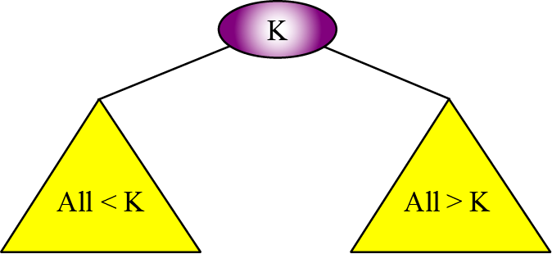
Binary Search Tree
A binary search tree (BST) is a binary tree with one extra property:
the key value of each node is greater than the key values of all nodes in each left sub tree and smaller than the value of all nodes in each right sub tree.
A very interesting property of a BST is that if we apply in-order traversal on it, the elements that are visited are sorted in ascending order.
BST can be used to maintain a sorted list in “ascending” order.

Slide 48
BST Example
Traverse the tree in Pre-order, In-order and post-order.

Slide 49
Operation on BST
Create(root)
isEmpty(root)
Traverse(root): Visit every node in the order relative to the hierarchy of the nodes in the tree.
Find(root, item): return the location of the data item in the tree if it is found; an appropriate flag otherwise.
Add(root, node): Adds to the tree a new node while maintaining the appropriate hierarchical relationships within the root.
Remove(root, node): Delete a node while maintaining the appropriate hierarchical relationship within the tree.

Slide 50
Create()
template <class T>
void Create(nodeTree<T> *& root){
root=NULL;
}

Slide 51
IsEmpty()
template <class T>
int IsEmpty(nodeTree<T> * root){
return root==NULL;
}

Slide 52
In-Order Traversal
template <class T>
void inOrder(nodeTree<T> * root) {
if (root !=NULL) {
inOrder(root->left);
“visit” root->data;
inOrder(root->right);
}
}

Slide 53
Find an item: returns a pointer to the node containing item; Null, otherwise. [Recursive Solution]
template <class T>
nodeTree<T> * find(nodeTree<T> * root, T item) { if (root ==NULL)
return NULL; else if (item == root->data) return root; else if (item < root->data) return find(root->left, item); else return find(root->right, item); }
Performance Analysis:
Best Case?
Worst Case?

Slide 54
Find an item: returns a pointer to the node containing item; Null, otherwise. [Iterative Solution]
template <class T>
nodeTree<T> * find(nodeTree<T> * root, T item) {
while (root != NULL)
{
if (item == root->data)
return root;
else if (item < root->data)
root = root->left;
else
root = root -> right;
}
return NULL;
}
Performance Analysis:
Best Case?
Worst Case?

Slide 55
Add an item in the BST
Inserting an item in the BST in such a way that the ordering property is preserved.
Analysis:
Is the insertion location unique for an item?
Conclusion: there can always be a unique position for an item to be inserted provided that it is added as a leaf.

Slide 56
BST Add Example
root
Add 37, 27, 84

Slide 57
BST Add Example
37
Add 37, 27, 84

Slide 58
BST Add Example
37
27
Add 37, 27, 84

Slide 59
Add an item into a BST - Recursive
template <class T>
void add(nodeTree<T> * & root, T item) {
nodeTree<T> * p;
if (root ==NULL){
p=new nodeTree<T>;
p->left=p->right=NULL;
p->data=item;
root = p;
} else if (item < root->data)
add(root->left, item);
else if (item > root->data)
add(root->right, item);
}
Q: Is duplicate data handled?
Performance Analysis:
Best Case?
Worst Case?

Slide 60
Add an item into a BST - Iterative
template <class T>
void addIterative(nodeTree<T>* & root, T item) {
p=new (nothrow) nodeTree<T>;
p->left=p->right=NULL;
p->data=item;
if (root ==NULL){
root = p;
} else { nodeTree<T> * newRoot = root;
int added = 0;
while (!added) {
if (item < newRoot->data) {
if (newRoot->left == NULL)
{newRoot->left = p; added = 1;}
else newRoot = newRoot->left;
} else if (item > newRoot->data) {
if (newRoot->right == NULL)
{newRoot->right = p; added = 1;}
else newRoot = newRoot->right;
}
}
}
Performance Analysis:
Best Case?
Worst Case?

Slide 61
Exercise
Build a BST on the following list of data:
45 36 76 23 39 56 89 27 37 41 48 69 115
69 37 36 39 48 115 89 41 76 27 23 45 56
Are the two BST structurally identical?
Compare the height of the two BST.
What conclusion do you draw from the above analysis?

Slide 62
Adding duplicate
There is three ways to achieve this.
Add duplicate to the left
Add duplicate to the right
Add duplicate on the node

Slide 63
Add an item into a BST Adding Add duplicates to the left
template <class T>
void add(nodeTree<T>* & root, T item) {
nodeTree<T> * p;
if (root ==NULL){
p=new (nothrow) nodeTree<T>;
p->left=p->right=NULL;
p->data=item;
root = p;
}else if (item <= root->data)
add(root->left, item);
else
add(root->right, item);
}

Slide 64
Add an item into a BST Add duplicates to the right
template <class T>
void add(nodeTree<T>* & root, T item) {
nodeTree<T> * p;
if (root ==NULL){
p=new (nothrow) nodeTree<T>;
p->left=p->right=NULL;
p->data=item;
root = p;
} else if (item >= root->data)
add(root->right, item);
else
add(root->left, item);
}

Slide 65
Add an item into a BST Add “dup” in the node
Node Construction/Declaration:
template <class T>
struct node {
T data;
int dup;
node * left;
node * right;
};
BST Construction:
nodeTree<T> * root;

Slide 66
Add an item into a BST with “dup”
template <class T>
void add(nodeTree<T>* & root, T item) {
nodeTree<T> * p;
if (root ==NULL){
p=new (nothrow) nodeTree<T>;
p->left=p->right=NULL;
p->data=item;p->dup=1;
root = p;
} else if (item == root->data)
root->dup++;
else if (item < root->data)
add(root->left, item);
else
add(root->right, item);
}

Slide 67
In-Order Traversal of a BST with “dup”
void inOrder(node * root) {
if (root !=NULL) {
inOrder(root->left);
for(int i=1; i<=root->dup; i++)
“visit” root->data;
inOrder(root->right);
}
}

Slide 68
Exercise
Build a BST on the following list of data:
25, 16, 10, 18, 19, 30, 14, 10, 10, 12, 16, 30, 25

Slide 69
Delete an item from BST
Delete an item from the BST in such a way that the ordering property is preserved.

Slide 70
Delete: Different Scenarios
Analysis:
Case 1: When the item to be deleted is a leaf
Case 2: Deleted element have only one sub tree(right or left sub tree)
Case 3: Deleted element has two sub tree

Slide 71
Case 1: Deletion of a Leaf Node
Given a leaf node N to be deleted which is the child of a parent node P then
Make its parent pointer that points to N null
Delete N
P
N
Node to be deleted

Slide 72
Case 2: Deletion of an Internal Node Having Only One Sub Tree
Given a node N to be deleted which has only right or left sub tree
Divert its parent pointer to its right or left sibling
Delete N
P
P
N
N
Node to be deleted

Slide 73
Case 2: Deletion of an Internal Node Having Only One Sub Tree
P
P
N
N
Node to be deleted

Slide 74
Case 3: Deleted element has Left & Right Sub Tree
Given a node N to be deleted which has left and right sub tree
Find the node with the maximum value from its left sub tree (in order predecessor of N) or the minimum value from its right sub tree (in order successor of N)
This gives you a node with a maximum of one sub tree
Swap the data of the two nodes
Delete the node with the search key (has zero or one sub tree)
P
Node to be deleted
N

Slide 75
Case 3:Max from Left & Min from Right
P
P
N
N
Max from Left
Min from Right

Slide 76
Case 3: Swap
P
P
N
Swap them
N
Swap them
Max from left
Min from Right

Slide 77
Case 3: After Delete

Slide 78
Case 3: Node to be Deleted
P
P
N
N
Node To be deleted
Node To be Deleted

Slide 79
Exercise: Delete
Root
50
70
20
30
Delete 8, 11, 14, 20
10
25
11
4
16
8
0
19
8
14
17
13
12

Slide 80
Delete an item from a BST : Implementation
template <class T>
void remove(nodeTree<T>* & root, T item) {
if(root != NULL){
if(item < root->data)
remove(root->left , item);
else if(item > root->data)
remove(root->right , item);
else{
nodeTree<T> * temp=root;
T data;
if(root->left == NULL){
root=root->right;
delete temp;
}else if(root->right == NULL){
root=root->left;
delete temp;
}else{
getPredecessor (root->left, data);
root->data=data;
remove(root->left, data); }
}
}
Root
50
70
20
30
10
40
25
11
4
16
8
0
19
14
17
13
12

Slide 81
Delete: getPredecessor…
Root
50
70
template <class T>
void getPredecessor(nodeTree<T>* root, T & data)
{
while(root->right != NULL)
root=root->right;
data= root->data;
}
20
30
10
40
25
11
4
16
8
0
19
14
17
13
12

Slide 82
Delete an item from a BST : Option2
template <class T>
void remove(nodeTree<T>* & root, T item) {
if (root !=NULL){
if (item < root->data)
remove(root->left , item);
else if (item > root->data)
remove(root->right, item);
else {
nodeTree<T> * q = root;
if (root->right == NULL)
root=root->left;
else if (root->left == NULL)
root=root->right;
else
del(q->left, q); // see next slide for del()
delete q;
}
}
Root
50
70
20
30
10
40
25
11
4
16
8
0
19
14
17
13
12

Slide 83
Delete an item from a BST : Option2
template <class T>
void del(nodeTree<T> * & root, nodeTree<T> * & q) {
if (root->right != NULL)
del(root->right, q);
else {
q->data = root->data;
q =root;
root = root->left;
}
}
Root
50
70
20
30
10
40
25
11
4
16
8
0
19
14
17
13
12

Slide 84
Something to Ponder
What is the Big-Oh for remove operation?

Slide 85
Delete an item from a BST with “dup”
Left as an exercise!

Slide 86
Analysis Binary Search Tree
In the best case analysis in which the binary search tree is balanced; search, insertion and deletion are the order of logn (O (logn)).
In the worst case analysis in which the binary search tree is left or right skewed; search, insertion and deletion are the order of O(n).
Compare with that of an array and linked list.

Slide 87
Expression Tree
An expression tree is a tree that represents an infix expression. At its leaves the tree contains operands (e.g., constants or variable names) and the internal nodes contain operators.
Nodes can have more than two children. A node also may have only one child, as is the case with the unary minus operator.
-
+
D
Binary Expression Tree
(A + B*C) - D
A
*
B
C
Traverse the binary expression using preorder, inorder and postorder traversal.
And give your observation.

Slide 88
Infix Algebraic Expression Exercise: (a + b/c)+ d * (e – f + g)

Slide 89
Expression Tree Exercise
Design an algorithm that constructs a tree for a binary algebraic postfix expression.
Note that it is difficult to construct a tree from its infix binary expression.
Use stack and the following algorithm:
When we see an operand, we create a single-node tree and push a pointer to it onto our stack.
When we see an operator, we pop and merge the top two trees on the stack.
In the new tree, the node is the operator, the right child is the first tree popped from the stack, and the left child is the second tree popped. We then push a pointer to the result back onto the stack.

Slide 90
Expression Tree Exercise
Design an algorithm that evaluates a binary algebraic expression.

Slide 91
Tree different cases
root
root
root
root
rn
rn
rn
right
Left
root
dst
rn
p
left
right

